Slide 1

Financial Aid & Scholarships
Bartram Trail High School Seniors
Class of 2027
Presented by your school counselors

Slide 2

What is Financial Aid ?
Financial aid is ANY Resource that can help
you pay for college.
  Grants - you do not have to pay back
  Scholarships - you do not have to pay back
  Work-Study - you do not have to pay back
  Loans - you DO have to pay back
You can use financial aid to help pay for:
  Tuition
  Room & Board
  Books
  Supplies
  Transportation

Slide 3
There are
FOUR
ways to get Financial Aid
for College
Federal Student Aid (FAFSA)
Florida Financial Aid (Bright Futures, etc.)
Institutional Financial Aid (Colleges)
Private Scholarships

Slide 4

Federal Aid
FAFSA stands for
Free Application for Federal Student
Aid
Who should apply?
EVERYONE – regardless of your parents’ income; many colleges require a FAFSA to be on file to receive a Scholarship.
When should you apply?
October 1st of your senior year AND every year after that while enrolled in college; remember this money is FIRST COME FIRST SERVED
What does this application cover?
Grants, Federal Guaranteed Student Loans, and Work-Study provided by the Federal Government
What do you need?
Tax forms/records, W-2 forms, social security number, driver’s license and FSA ID
How do you apply?
Go to: https://www-bths.stjohns.k12.fl.us/guidance/fafsa-free-application-for-federal-student-aid/ for direct access to the application, instructions on how to create your FSA ID, complete the application and tips & resources.

Slide 5
Florida Financial Aid
Bright
Futures
Who should apply?
EVERYONE
When should you apply?
Application opens October 1st
What does this application cover?
14 different Grants and Scholarships provided by the State Government, including Bright Futures.
How do you apply?
Go to http://www.floridastudentfinancialaid.org/
Helpful hints guide located here: http://relschoolcounseling.weebly.com/resources--frequently-used-documents.html
This money is NOT first come first served!

Slide 6
What if I plan to attend college out of state?
If you apply and qualify during your Senior year, the scholarship money is available for up to FIVE years!
A lot can happen in FIVE years!
So, we highly encourage ALL seniors to apply today and try to meet the requirements!

Slide 7
You cannot have too many scholarships!
Once you decide on which college you plan to attend, all of your scholarship money will go into your financial aid account at the college.
Your scholarship money will be applied towards your tuition, room & board, books, etc.
Any extra money will be given BACK TO YOU! You can use that money for gas, a car payment, clothes, etc.
What if I already
have FL Prepaid
or another scholarship?

Slide 8

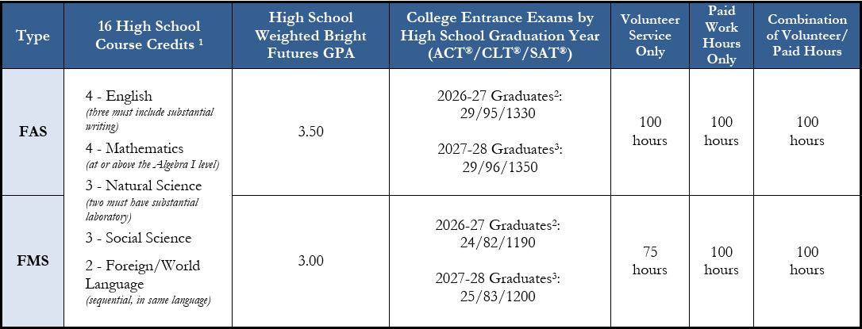
Florida Academic Scholars (FAS) Award – 100% paid Tuition
and
Florida Medallion Scholars (FMS) Award – 75% paid Tuition
You must send your test scores to a FL public College/University.
This is NOT your Bartram GPA!
You only need one of these test scores.
Notes:
,

Slide 9
Florida Gold Seal Vocational (GSV) Award
The Florida Gold Seal Vocational Scholars (GSV) award may be funded if a student is
enrolled in a career education or certificate program.
Examples: an Applied Technology Diploma, Technical Degree Ed Program (Associate in Applied Science or
Associate in Science), or a Career Education Certificate Program.
To qualify for the GSV award must meet the following initial eligibility requirements:
Achieve the required weighted minimum 3.0 GPA in the non-elective high school
courses.
Take at least 3 full credits in a single Career and Technical Education program.
Achieve the required minimum 3.5 unweighted GPA in the career education courses.
Achieve the required minimum score on the ACT®, SAT® or Florida Postsecondary Education
Readiness Test (P.E.R.T.)
Complete 30 volunteer service OR 100 paid work hours.
Achieve the required minimum score on one of the college entrance exams per the chart no later than August 31 of the year the student graduates from high school.
Notes:
,

Slide 10
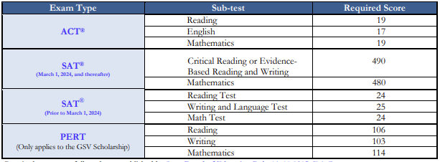
Florida Gold Seal Vocational (GSV) Award
Testing Requirements
You only need one of these test scores and you must send your ACT/SAT scores to a FL public College/University.
Notes:
,

Slide 11

Bright Futures Student Handbook 2026-2027
Chapter 1: Eligibility
You must APPLY for the scholarship by submitting the Florida Financial Aid Application. We are doing this today!
Your Bright Futures Scholarship will renew automatically each year if you maintain the required GPA and credit hours.
If you are planning to apply for Bright Futures, you should be accumulating community service/work hours and turning them in to the Guidance desk. Do not wait! Hours must be turned in before Graduation Day!
You must submit the Volunteer Service Plan sheet with your hours. This form is on Ms. Richard’s desk in Guidance.
If possible, you should try to meet all Bright Futures requirements by the end of the first semester.
Notes:
,

Slide 12
Bright Futures Student Handbook 2026-2027
Chapter 1: Eligibility
Remember, your Bright Futures GPA is NOT the same as your Bartram GPA.
Bright Futures weighs honors, AP, and dual enrollment classes equally with 0.5 per credit earned – NOT 1.0 weight
Bright Futures will accept two additional academic electives toward the GPA calculation if it benefits the student.
You are permitted to use qualifying scores from the ACT-CLT- SAT through August 2027, to qualify for the Bright Futures test requirement.
Notes:
,

Slide 13
What should seniors do now to qualify for a Bright Futures Scholarship?
  See your school counselor if there are any errors on your transcript.
  Review your Bright Futures Report.
  Take note of what is “Missing” to qualify for each award.
  Take steps to improve your Bright Futures GPA if
  it is borderline. Finish any SJVS, FLVS or
  Edmentum courses ASAP!
  Take or re-take ACT-CLT-SAT and report your scores to a Florida school. Remember Bright Futures super-scores your tests.
  Try to submit any remaining service/work hours by winter break.

Slide 14
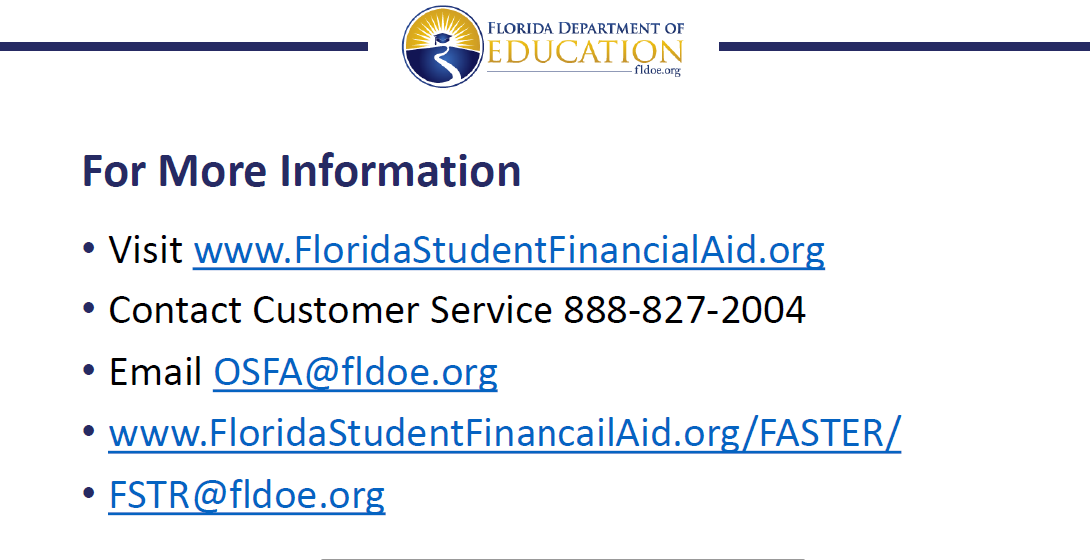
If you have issues or further questions specific to the application, please contact the Office of Student Financial Aid.

Slide 15


Who should apply?
EVERYONE! Talk to the college/university financial aid office to determine what programs for which you qualify. This is FIRST COME FIRST SERVED!
When should you apply?
EARLY! Contact the college/university for their specific deadlines.
What does this application cover?
Grants and Scholarships provided by the college/university.
What do you need?
Usually, the FAFSA has to be filled out first, but contact the college/university to find out more information.
How do you apply?
Colleges and Universities generally have a separate application process for financial aid.
Institutional Financial Aid

Slide 16
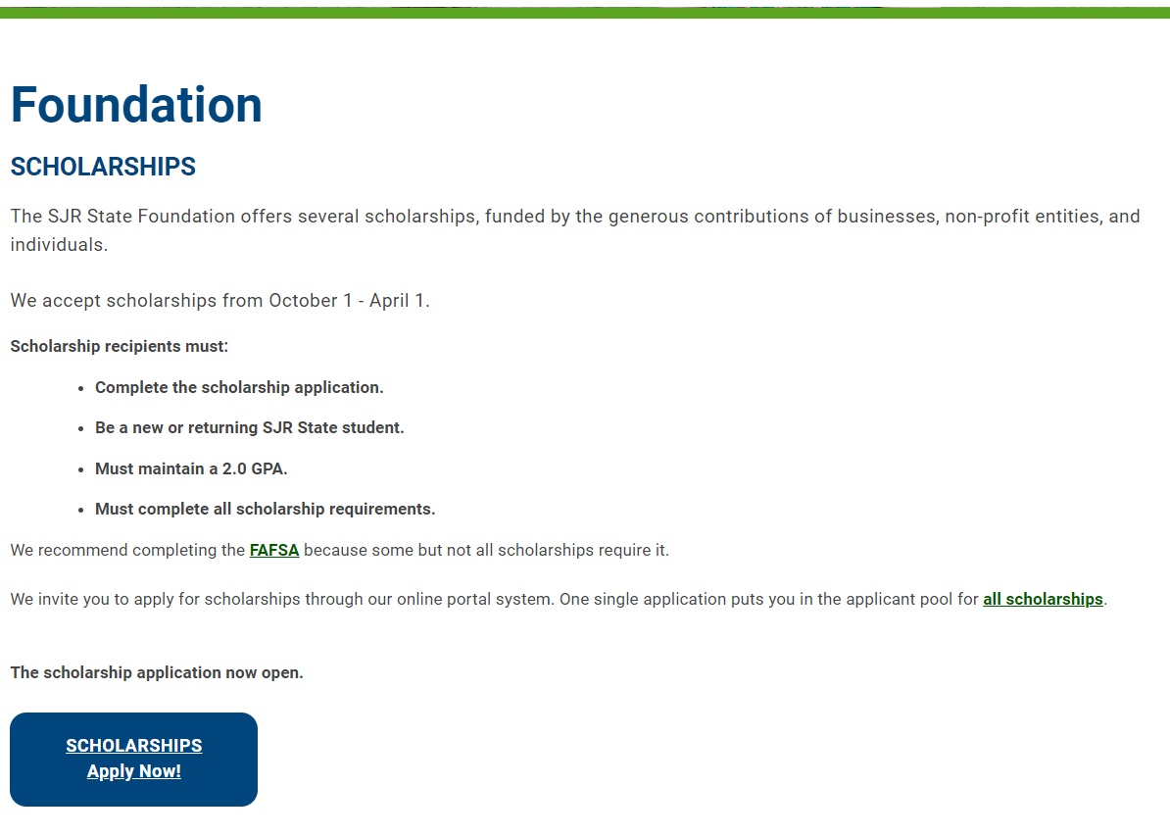

Go TO: https://sjrstate.edu/scholarships
St. Johns River State College
has Scholarships!
Applicants can apply beginning October 1st through April 1st.

Slide 17
Who should apply?
EVERYONE
When should you apply?
NOW and continue searching
For scholarships even when
you’re in college.
What do you need?
Complete the scholarship application, your transcript (use Parchment), essay, and possibly a resume of activities and SAT/ACT test scores.
How do you find scholarships? Lots of places!
Bartram Trail High School Counseling Website
Student’s Employers
Parent Employers
Church and Civic Organizations
National, State and Local Organizations
Corporations
Special Interest Groups
Private Scholarships
Remember…
you cannot get too many scholarships!

Slide 18
Scholarship Tips
Scholarships are available NOW!
Apply to EVERY scholarship for which you are eligible.
Make a list of deadlines and don’t miss them!
Review your social media accounts and remove inappropriate material.
Create a dedicated scholarship email address: FirstName.LastName@gmail.com and make sure it’s appropriate.

Slide 19
Scholarship Essay
Tips
Follow directions – use accurate word count and font size, make sure to follow the requirements.
Focus on the topic - answer the question that is being asked, stick to the prompt and try approaching the topic in a creative way.
Proofread and edit your work - be clear, concise, and correct any errors.
Get feedback - ask a teacher or family member to read your essay and provide feedback.
Essays can often be reused and tailored for each new scholarship.

Slide 20

You can search Google, just beware of Scams!
NEVER pay for scholarships or searches.
Feel too good to be true? It probably is! Do more research!
Trust your instincts.
Scholarships are gifts; they never have to be repaid.
Never give out bank account, credit card, or social security information.

