Slide 1
GRADUATION REQUIREMENTS
Bartram Trail High School Counselors

Slide 2

Graduation requirements for a Standard 24 Credit Diploma
Assessments (Algebra 1 EOC and Grade 10 ELA FAST Test)
2.0 Cumulative, Unweighted GPA
24 specific credits
Notes:
Students must earn 28 “CHECKS” for graduation in order to earn a standard 24 credit diploma.

Slide 3
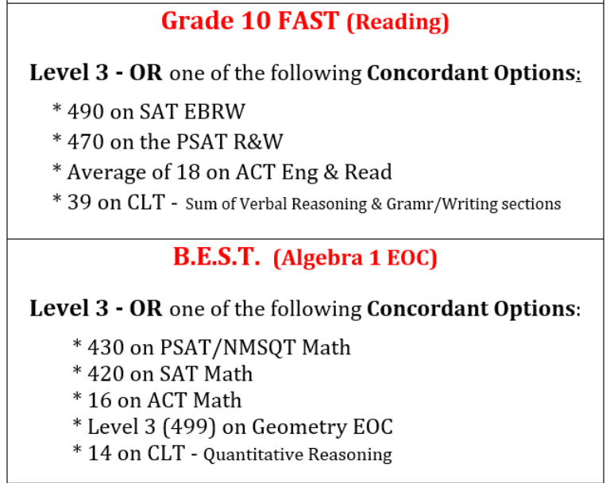
Assessments
Students must pass two state assessments to graduate – The Grade 10 FAST ELA and the B.E.S.T. Algebra 1 EOC. Students may earn a concordant score for each test in lieu of passing the FAST and/or the B.E.S.T.
Notes:
PSAT/NMSQT will be administered on October 21st 2026. The deadline to sign up has passed. All 10th graders will be automatically scheduled to take the test free of charge. 9th and 11th graders must register and pay the fee by the deadline to receive score reports. If students think they took the PSAT/NMSQT at a previous school, they will need to log into their College Board account and give the school counselor their official score report.

Slide 4

Credits
24 credits must be earned in all of the following:
  English 1, 2, 3, and 4
  Algebra, Geometry, and two additional Math courses
  Biology and two additional Sciences
  World History, US History, Government, and Economics
  1 Fine/Performing/Practical art or CTE
  HOPE
  8 elective credits (to include .5 credit of Personal Finance and Money Management)
    If you’re planning to attend college, you will need two credits in the SAME world language
Notes:
Any math or science course that is offered at Bartram will count towards credits needed for graduation.

Slide 5

Grade Point Average - GPA
GPA - 2.0 cumulative unweighted or higher
  2.0 is a “C” average
  Check HAC regularly to keep track of grades
Notes:
A minimum of 2.0 GPA is needed to graduate. An unweighted GPA of 3.0 is needed for Dual Enrollment and College Admissions GPA is weighted and higher than 3.0. Students are encouraged to earn great grades and boost their GPA whenever their semester grades or final grades are low.

Slide 6
Grade Recovery
Students who have earned a grade of D or F in a course can retake the course for grade recovery online or through Edmentum. Once the new higher grade is earned the Registrar’s office will zero out the F or D previous grade and replace it with the higher grade. Please note that the original grade of D or F will remain on the transcript but will not affect the GPA.
NCAA guidelines – collegiate athletes cannot take grade recovery through Edmentum but must complete grade recovery on FLVS or SJVS.
The state allows for grade averaging one failed semester with a passing semester to pass a course and earn credit, if possible . We still recommend re-taking the half credit failed course for grade recovery.
The FLVS website for online grade recovery is www.flvs.net Students may also choose St. Johns Virtual (SJVS) at www.stjohnsvirtual.com, which is the district online option. Counselor approval is needed to take any course for grade recovery.
During registration, grade recovery labs can be added on a student’s BTHS schedule to complete during the school year. Prior to summer break Counselors will recommend grade recovery courses through Edmentum that can be completed at home over the summer months.
Notes:
It is highly recommended that students who earn a grade of D or F re-take the course for grade recovery.

Slide 7

Promotion Requirements
9th to 10th Grade
  5 credits
10th to 11th Grade
  11 credits
11th to 12th Grade
  17 credits
Notes:
Students will be automatically retained if they do not earn sufficient credits to be promoted to the next grade level. They can be promoted any time during the school year once they have the required credits for promotion.

Slide 8

What you need to know about GPA:
  GPA’s update after every semester:
    In January, after semester 1 grades post
    In the summer, after semester 2 grades post
  AP, Dual Enrollment, AICE, and honors counts towards your weighted GPA
  Only a student’s unweighted GPA counts towards graduation
Notes:
If a student has already taken a high school course, they already have a GPA. All GPA’s will update after semester 1 grades are posted.

Slide 9
Calculating Unweighted GPA
Course | Grade | Point Value
English 1 | B | 3
Algebra 1 | A | 4
World Cultural Geography | C | 2
Env. Science | D | 1
HOPE | A | 4
2-D Studio Art | B | 3
Digital Info Tech | C | 2
 | Total Points | 19
 | Total Classes | 7
19/7 = 2.71 | Unweighted GPA | 2.71
A – 4 points
B - 3 points
C - 2 points
D – 1 point
F – 0 points
Notes:
Honors – 0.5 weighting
AP and Dual Enrollment courses – 1.0 weighting

Slide 10
Thank You!
A special thanks for joining our BTHS Guidance Fall Virtual Presentations.
We look forward to working with your student this school year and we wish them continued success as they navigate their high school journey.

