Slide 1

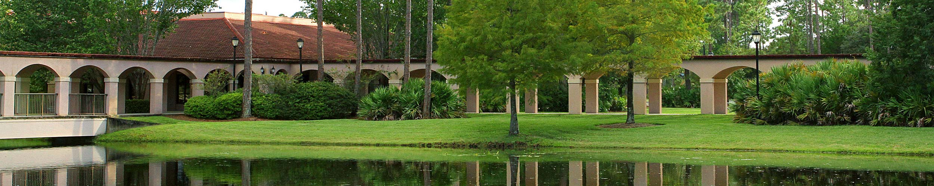
Dual Enrollment
St. Johns River State College
BTHS School Counselors

Slide 2
https://www-bths.stjohns.k12.fl.us/guidance/dual-enrollment-sjrsc/
Please visit the link called
‘Dual Enrollment
at St. Johns River State College’
on our School Counseling Website.
It is recommended both students and parents read the Dual Enrollment Frequently Asked Questions as this covers a lot of questions we often receive.

Slide 3
Why Choose Dual Enrollment?
Dual Enrollment gives high school students the opportunity to earn both high school and college credits simultaneously.
Students can expedite their path to a college degree by starting in high school.
Students can earn transferrable college credit.
Students can save money on college courses.

Slide 4
Programs Offered through
Dual Enrollment
Traditional Dual Enrollment: Traditional Dual Enrollment provides eligible accelerated high school students the opportunity to simultaneously earn both college credit and a high school diploma. It is recommended that students take no more than ten (10) Dual Enrollment credits in the fall and spring terms, and six (6) Dual Enrollment credits for the summer term.
Early Admission: Early Admission is a form of Dual Enrollment which allows eligible high school junior and senior students to enroll in a recommended minimum of twelve (12) and a maximum of sixteen (16) Dual Enrollment credits per fall and spring term, and six (6) Dual Enrollment credits for the summer term. Early admission students may only attend college courses and may not be enrolled in any high school classes.
Early College Program: This program allows admitted students to complete 6O credits of Dual Enrollment coursework, culminating in earning both a standard high school diploma as well as an Associate of Arts (AA) Degree upon the completion of four years of high school. This program is offered at Tocoi Creek High School and Pedro Menendez High School, and students must begin the Early College Program in the 9th grade.

Slide 5

Dual Enrollment Eligibility
Minimum 3.0 unweighted high school GPA
  Maintain a 3.0 unweighted high school GPA and a 2.0 college GPA to stay in the DE program
Have taken a placement test that is less than two years old and provide an OFFICIAL copy of the test scores
  ACT, PSAT, SAT, or PERT
  Specific qualifying scores are needed for English Composition and College Algebra
Have you’re their own transportation if taking courses on the college campus

Slide 6
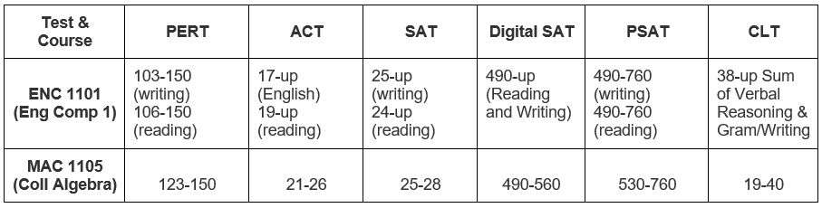
Dual
Enrollment Placement Testing
As previously mentioned, students must provide an official copy of their test scores.
Students do not need a minimum test score in order to begin Dual Enrollment, BUT they will need certain college-ready test scores if they wish to take certain courses.
These courses include:
ENC 1101 – English Composition
MAC 1105 – College Algebra

Slide 7
Course Delivery Options
SJR State Campus – In-person course at the St. Augustine, Orange Park or Palatka campus that meets at specific dates and specific times.
Online - Students complete the course completely online with no meeting times.
LIVE Online – Similar to online but students will be required to meet and sign in on their computer on specific dates and times, i.e. – Tuesdays and Thursdays from 6-7:30pm while at home on their computer.
Hybrid – Students have a mix of online and meeting in-person at one of the 3 campuses.

Slide 8
Transferring Dual Enrollment Courses
Credits taken through Dual Enrollment at SJRSC can transfer to the Florida State University System (SUS) due to the Florida Common Course Numbering System and the statewide articulation agreement.
Upon high school graduation, if students do not attend the same college or university where they earned their dual enrollment credit, the application of transfer credits to general education, prerequisite, and degree programs may vary at the receiving institution.
For out-of-state and private colleges, students will need to check with the individual schools to inquire whether their dual enrollment credit will be accepted to transfer.

Slide 9
Grades and
GPA
It’s important for students to know that Dual Enrollment is the start of their college transcript.
These grades affect college admissions, Bright Futures, and financial aid eligibility.
Students that earn a ‘D’ or ‘F’ or Withdrawal from a course will be removed from the DE program. Students are only permitted to petition the DE office ONE time requesting to remain in the program.
If a student’s high school GPA drops below 3.0, they will be removed from the DE program.
Students are only permitted to earn up to 6O credits through Dual Enrollment.

Slide 10

Expectations of
Dual Enrollment Students
Students handle ALL communication themselves. Once a dual enrollment student they are classified as a college student and all communication between the SJRSC office and professors must come through the student, not the parent.
Students need to have the academic, social and emotional maturity to handle DE college level courses.
Students need to identify if they are having an issue with a course, instructor, or assignments and be able to handle the issue and communicate it appropriately in a timely manner.
SJRSC expects students to log in to their MySJRstate account and check their SJR State email daily as this is the main form of communication that the professors and the DE office will have with students.

Slide 11
Dual Enrollment Application and Registration Process
When considering DE, students should consider the rigor and time commitment of their BTHS courses, the time needed for outside commitments and whether they meet the eligibility requirements. They should consult their School Counselor about these things and get any questions answered before the process begins.
Students will be notified via Schoology when the registration packets are available to pick up in the main Guidance office (packets will also be available online on the School Counseling Webpage). There will be a packet for ‘New’ students to DE and a packet for ‘Returning’ students. These packets have a LOT of important information and specific steps students must follow.
We understand new to DE students may need parental assistance with completing the steps in the packet, but we kindly ask that parents do not complete the packet nor enroll their student into courses themselves. Students wanting to take college level courses need to learn how to complete these important steps.

Slide 12
Dual Enrollment Application and Registration Process
Dual Enrollment Academic Calendar and Important Dates
https://www.sjrstate.edu/dual-calendar
Textbooks and Access Codes – these come from the St. Johns School District Media Services Department, NOT from the college!
https://www.stjohns.k12.fl.us/media/de-textbook-requests/

Slide 13
Academic Student Resources
Library and Academic Support Services - learningresources.sjrstate.edu
Free On Campus Tutoring - learningresources.sjrstate.edu/Tutoring
Career Services - advising@sjrstate.edu
to schedule an appointment
Academic Advising - advising@sjrstate.edu
to schedule an appointment

Slide 14
If your student has questions about the Dual Enrollment program at
St. Johns River State College, please encourage them to speak with their school counselor!
Thank you!

