Slide 1

Dual Enrollment
BTHS School Counselors

Slide 2
Why
Dual & Secondary Enrollment
At
FCTC?
Experience hands-on training
Fast-track your path to success by learning a trade or skill
Head start to receiving industry certifications or licensures
Save time and money by earning credits for free
Exploration of high skill, high wage jobs

Slide 3
Dual Enrollment
Secondary Electives
OR
Completed hours go towards certifications
Courses can take longer than one semester to complete
Credits awarded are based on completion of course
GPA requirement
Assessment requirement
FLDOE post-secondary curriculum /frameworks
Elective credits toward high school diploma
Credits attained (per semester) can apply towards licensure and/or certification
Licensure or certification can be obtained based on program and length
Science credit in Horticulture
FLDOE high school curriculum/ frameworks

Slide 4
Good attendance and discipline record
2.0 unweighted GPA for dual enrollment only
On track for graduation
Room in the student’s schedule for a minimum of two consecutive periods (some courses may require additional periods)
Students must make sure to communicate their interest to their high school Counselor.
Students must have their own transportation
Requirements for
Enrollment

Slide 5

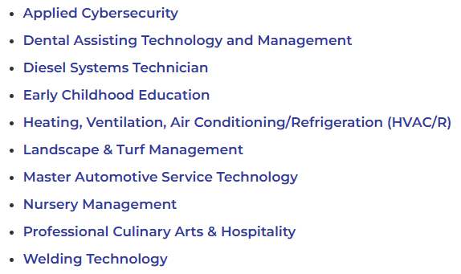
Dual Enrollment Programs
Application Deadlines
Fall Term 2027
Available November 2026
Due February 2027
https://fctc.edu/students/highschool/dual-enrollment/de/

Slide 6
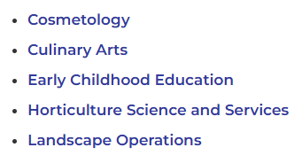
Secondary Elective Programs
Application Deadlines
Fall Term 2027
Available November 2026
Due February 2027
https://fctc.edu/students/highschool/dual-enrollment/secondary

Slide 7
FCTC
Student Advisors
Dual Enrollment Questions
Sam Guldswog
904-547-3379
Secondary Enrollment Questions
Wakilah Augustus
904-547-3378

Slide 8
Dual Enrollment
FCTC.edu

Slide 9

Permission Slips are in the guidance office.
Permission slips are due back by October 23rd.

Slide 10
THANK YOU

