Slide 1

College and Career Exploration
Guiding future paths through informed education and career choices
BTHS School Counselors
Notes:
---

Slide 2
Introduction to College and Career Exploration
Notes:
Welcome and Overview, Importance of Planning

Slide 3

Overview
Purpose of Presentation
  Introduce students and parents to college and career pathways after high school. Highlight the session’s goal to inform and empower decision-making.
Exploring Pathways
  Discuss different options including universities, technical programs, and workforce entry. Provide clarity on requirements and opportunities.
Supporting Student Decisions
  Equip families with resources and guidance to make informed future plans. Emphasize support available throughout the journey.
Notes:
Welcome students and parents to this informative presentation on college and career exploration tailored specifically for Florida public high school students. This session aims to provide a comprehensive understanding of the various pathways available after high school, including college options, career opportunities, and the requirements needed to pursue them. By exploring these topics, students and parents will be better equipped to make informed decisions about the future. Whether the goal is to attend a university, enroll in a technical program, or enter the workforce, this presentation will guide you through the essential steps and resources available to support your journey.

Slide 4
Importance of Planning
Goal Setting Benefits
Planning helps students set realistic academic and career goals for a successful future.
Exploring Options
Early planning allows exploration of various career paths and educational opportunities.
Parental Support Role
Involvement of parents provides essential support and guidance during planning.
Notes:
Planning for college and career is a critical step in a student's educational journey. It helps students set realistic goals, understand the various options available, and prepare effectively for life after high school. Early planning allows students to align their academic efforts with their career aspirations, explore different fields of interest, and identify the necessary qualifications and experiences needed to succeed. For parents, being involved in this process ensures that they can provide the necessary support and guidance. Together, students and parents can navigate the complexities of post-secondary education and career choices with confidence and clarity.

Slide 5
Academic Pathways
Notes:
Florida High School Graduation Requirements, College Pathways, Career Pathways

Slide 6

College Pathways
State Universities
  State universities offer four-year degree programs with diverse academic options and research opportunities.
State Colleges
  State colleges provide two-year associate degrees, four-year bachelor degrees, pathways to transfer to four-year universities, and technical and career certifications.
Technical Colleges
  Technical colleges emphasize vocational training and certifications preparing students for specific careers.
Private Institutions
  Private colleges often offer specialized programs tailored to niche academic and career goals.
Notes:
Florida offers a variety of college pathways for high school graduates. These include state universities, community colleges, technical colleges, and private institutions. Each pathway has its own set of admission requirements, program offerings, and career outcomes. State universities typically offer four-year degree programs, while community colleges provide two-year associate degrees and transfer opportunities. Technical colleges focus on vocational training and certifications, and private institutions may offer specialized programs. Exploring these options allows students to choose a path that aligns with their interests, academic strengths, and career goals.

Slide 7

Career Pathways
Career and Technical Education
  CTE programs provide hands-on training in healthcare, IT, and automotive services to prepare students for careers.
Apprenticeships
  Apprenticeships blend classroom instruction with on-the-job experience, offering practical employment routes.
Certifications and Workforce Entry
  Certifications validate skills and enhance job prospects for direct entry into the workforce.
Parental Support
  Parents can encourage career exploration and support students’ interests to help guide career decisions.
Notes:
Career pathways in Florida include Career and Technical Education (CTE) programs, apprenticeships, and direct workforce entry with certifications. CTE programs provide hands-on training in fields such as healthcare, information technology, and automotive services. Apprenticeships combine classroom instruction with on-the-job training, offering a practical route to employment. Certifications validate specific skills and can enhance job prospects. These pathways are ideal for students who prefer a more direct route to employment or wish to gain experience while continuing their education. Parents can help by encouraging exploration of these options and supporting their child's career interests.

Slide 8
Resources and Requirements
Notes:
Exploration Tools, College Admission Requirements, Financial Aid Options

Slide 9
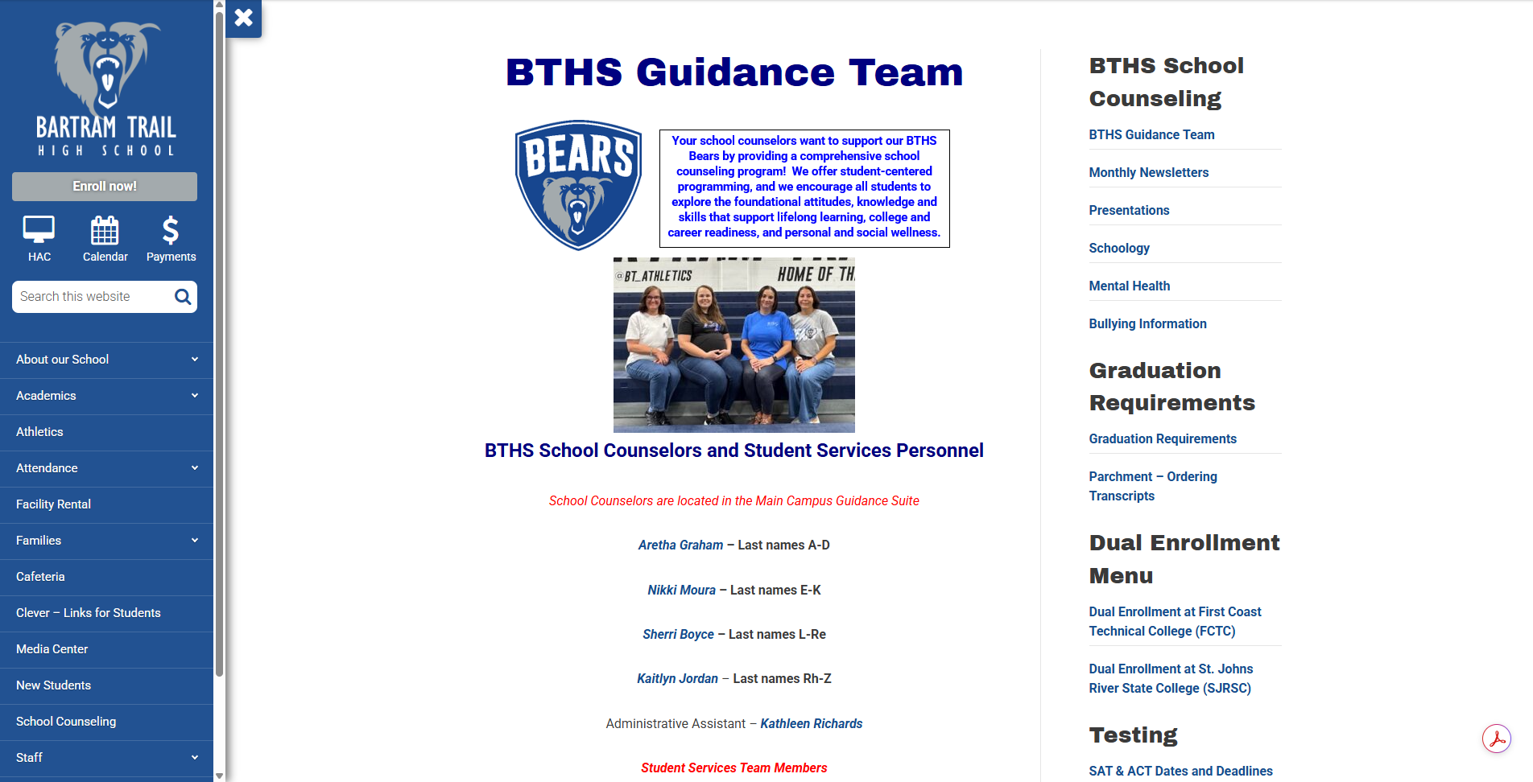
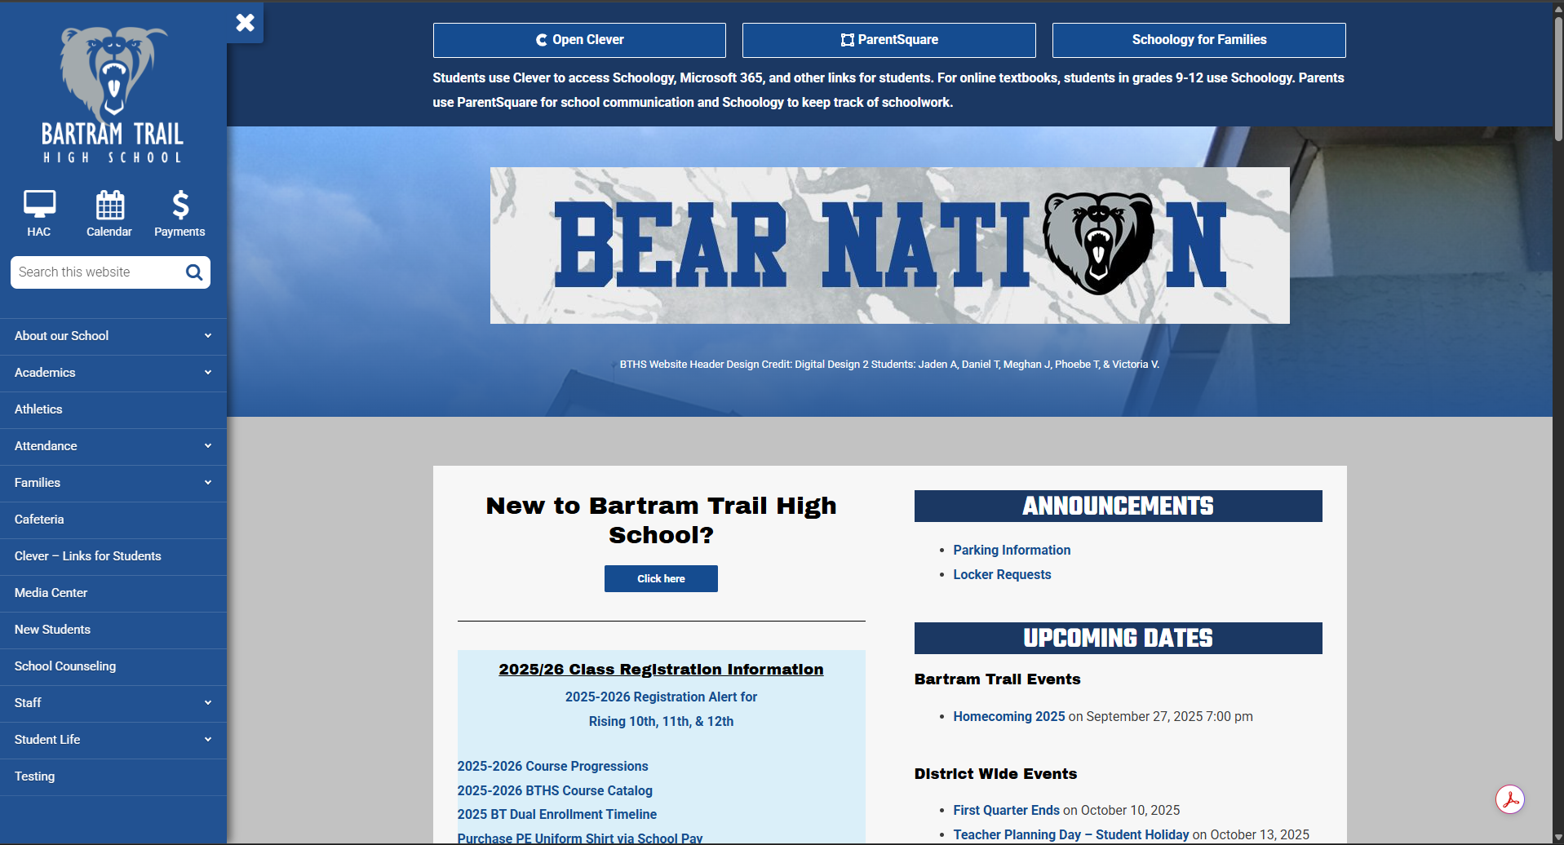
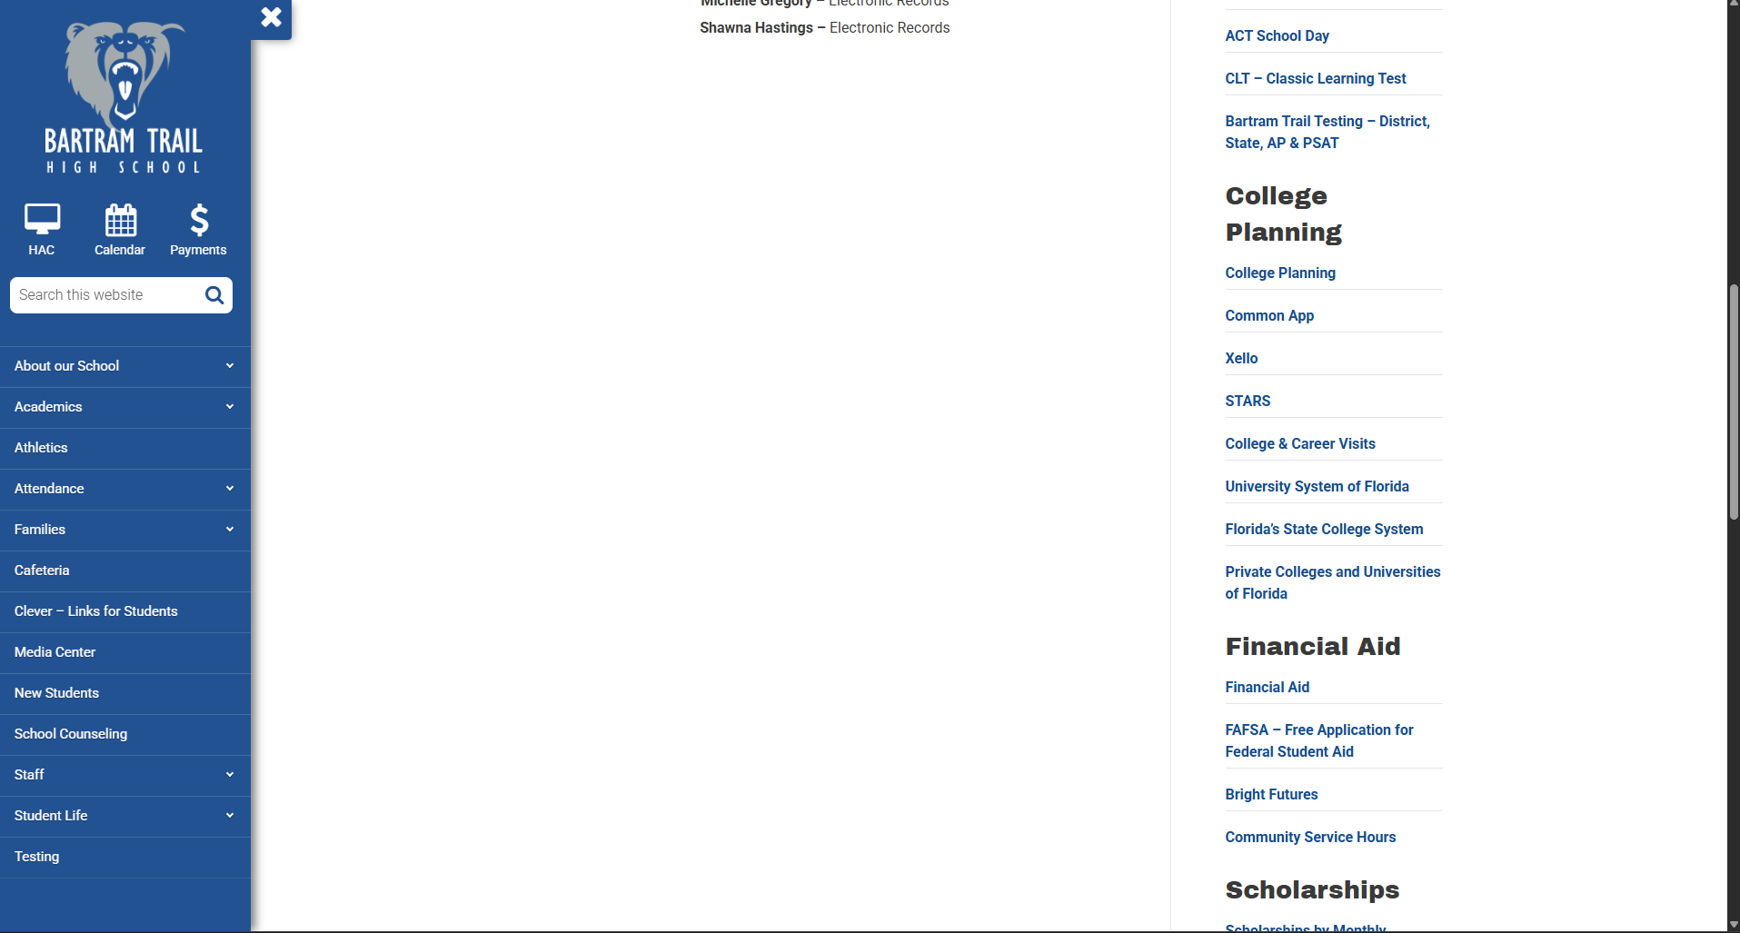
College Planning on the BTHS school counseling Webpage
https://www-bths.stjohns.k12.fl.us/guidance/college/
Go to the BTHS website
Click on School Counseling
Scroll down to the College Planning Section
Scroll
Down

Slide 10

Exploration Tools
Academic Planning Resources
  Xello provides comprehensive academic planning and career exploration tools for students.
Standardized Testing and Admissions
  The College Board, ACT, and CLT offer information on standardized tests and college admissions to help students prepare effectively.
Goal Setting and Applications
  Xello supports goal setting and college application management, streamlining students' planning processes. Integrate Xello and Common App to complete college applications through The Common App.
Parental Involvement
  Encouraging regular use of these tools and discussing results with parents enhances student planning success.
Notes:
Several tools are available to help Florida students explore college and career options. FloridaShines.org and MyCareerShines offer comprehensive resources for academic planning and career exploration. The College Board provides information on standardized testing and college admissions. Naviance, if available at the school, supports goal setting and college applications. These platforms allow students to research institutions, compare programs, and assess career interests. Utilizing these tools can make the planning process more manageable and effective. Parents should encourage their children to regularly use these resources and discuss findings together.

Slide 11

College Admission Requirements
Academic Performance
  GPA and standardized test scores demonstrate a student's readiness for college-level work and are key admission components.
Extracurricular Activities
  Involvement in extracurriculars highlights leadership skills and commitment beyond academics.
Personal Statements and Recommendations
  Essays provide insight into a student's character while recommendation letters offer external validation of abilities.
See State University System of Florida’s admissions matrix on the next slide
Parental Support
  Parents help by organizing documents, reviewing essays, and encouraging meaningful student activities.
Notes:
College admission requirements vary by institution but generally include GPA, standardized test scores (SAT/ACT), extracurricular activities, personal statements, and recommendation letters. A strong academic record demonstrates readiness for college-level work, while involvement in extracurriculars showcases leadership and commitment. Personal statements provide insight into a student's goals and character, and recommendation letters offer external validation. Preparing for these requirements early ensures that students can present a well-rounded application. Parents can assist by helping gather documents, reviewing essays, and encouraging participation in meaningful activities.

Slide 12
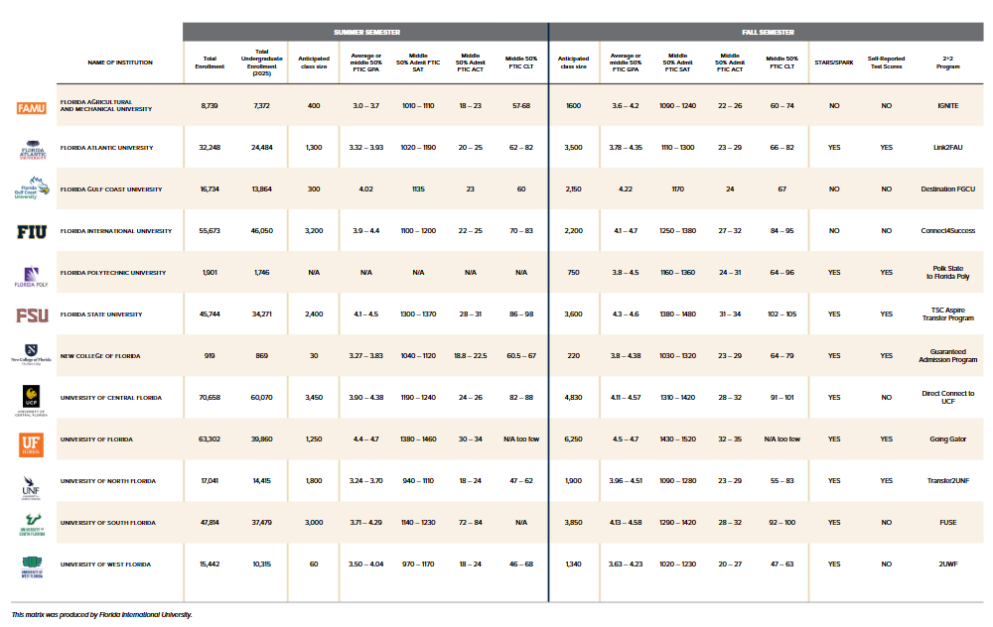

Slide 13
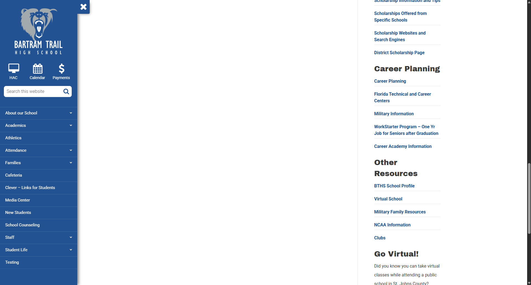
Career Planning on the BTHS school counseling Webpage
https://www-bths.stjohns.k12.fl.us/guidance/college/
Go to the BTHS website
Click on School Counseling
Scroll down to the Career Planning Section
Scroll
Down

Slide 14
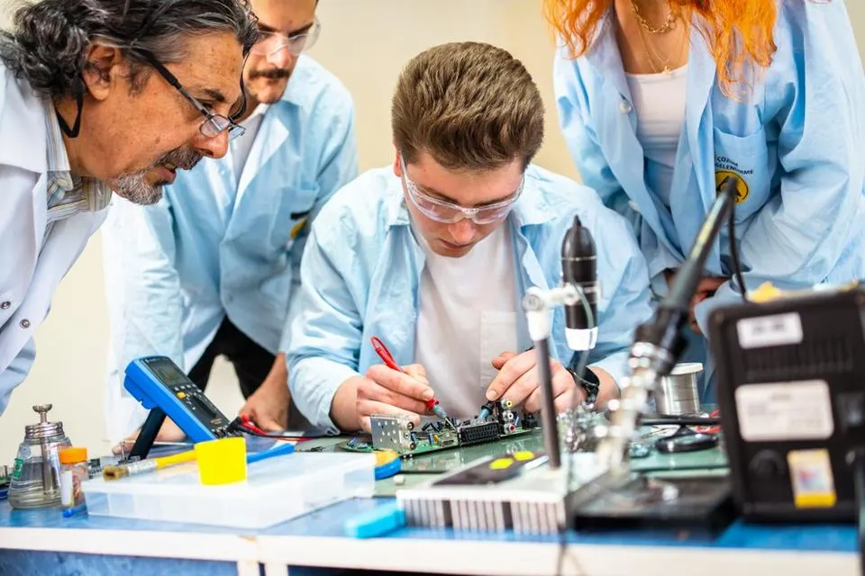
Career & Technical Education
Academic Performance
  Strong academic skills can enhance success in technical fields. Some programs may have prerequisites or require entrance exams, so academic performance can affect access and readiness.
  Students must earn a high school diploma or equivalent.
See next slide for links to local Career and Technical Education Programs.
Parental Support
  Parents help by encouraging students to find a meaningful career path and organizing documents.
Notes:
College admission requirements vary by institution but generally include GPA, standardized test scores (SAT/ACT), extracurricular activities, personal statements, and recommendation letters. A strong academic record demonstrates readiness for college-level work, while involvement in extracurriculars showcases leadership and commitment. Personal statements provide insight into a student's goals and character, and recommendation letters offer external validation. Preparing for these requirements early ensures that students can present a well-rounded application. Parents can assist by helping gather documents, reviewing essays, and encouraging participation in meaningful activities.

Slide 15





Career & Technical Education Programs
Click each picture to visit their website

Slide 16
Support and Next Steps
Notes:
Parent Involvement, Next Steps for Students and Parents

Slide 17

Next Steps for Students and Parents
Explore Interests and Research
  Use assessments and research to identify interests and suitable college and career pathways.
Schedule a Visit
  Students and parents should visit any prospective colleges (including career & technical schools). If the student is in good standing with their attendance, these will be excused absences with evidence of your visit.
Create Plan and Timeline
  Develop a detailed plan and timeline to complete necessary tasks and stay on track for success.
Monitor Progress Together
  Parents and students should collaborate to track progress and adjust plans as needed throughout high school.
Notes:
To begin the journey toward college and career success, students and parents should schedule a meeting with the school counselor to discuss goals and available resources. Exploring interests through assessments and research helps identify suitable pathways. Researching colleges and careers provides insight into requirements and opportunities. Creating a plan and timeline ensures that tasks are completed in a timely manner. Staying organized and proactive throughout high school will lead to better outcomes. Parents and students should work together to monitor progress and adjust plans as needed.

Slide 18

Parent Involvement
Academic Support
  Parents encourage good study habits and stay informed about academic requirements to support student success.
Career Exploration
  Parents promote exploration by discussing interests and attending college and career events with students.
Application Assistance
  Assisting with college applications and financial aid processes ensures timely and accurate submissions.
Collaborative Engagement
  Building partnerships with counselors and educators enhances the college and career planning experience.
Notes:
Parental involvement plays a vital role in a student's college and career planning. Parents can support academic success by encouraging good study habits and staying informed about school requirements. They should also promote exploration by discussing interests and attending college and career events. Assisting with applications and financial aid processes ensures that students meet deadlines and submit accurate information. Active engagement helps students feel supported and confident in their decisions. Building a collaborative relationship with school counselors and educators further enhances the planning process.

Slide 19
Thank you!

