Slide 1

Scholarships &
Bright Futures
Presented by Kaitlyn Jordan
BTHS School Counselor

Slide 2
Counselors will be providing Financial Aid Workshops for Seniors during the month of October through English classes.
Those students without an English class at BTHS will have an opportunity to sign up for a separate workshop.

Slide 3
The 4 types of financial Aid
There are various ways students can seek Financial Aid to help pay for College.
Federal Aid – Apply for the FAFSA beginning December 1st
State of Florida Aid – Bright Futures & Special Interest Scholarships
Institutional Aid – Visit the college and university websites
Private Aid – Search for Scholarships via national, state and local organizations

Slide 4
Scholarships
(private Aid)
Provide financial support for students to help pay for college
Enable students to obtain education they may not have access to otherwise
Help reduce debt
Student’s can earn multiple scholarships,
there is no limit!

Slide 5
Before students begin the process for applying for Scholarships, they need to GET ORGANIZED!
ACT/SAT/CLT test scores
Unofficial high school transcripts – students should order a transcript to be sent to their email through Parchment
  link is found on the main BTHS website
Letter of recommendation from teacher(s)
Create a resume of activities, community service, leadership roles and skills
Essays
  you may be able to use the same one for multiple scholarships

Slide 6
Next Steps
Create a dedicated scholarship email account with an appropriate email address
  Firstname.lastname@gmail.com
Review social media accounts and remove inappropriate material
Make a list of deadlines and don’t miss them
When writing essays, make sure to follow all directions exactly, stick to the prompt, use the accurate word count, and try approaching the topic in a creative way
Essays can often be reused and tailored for each new scholarship
Apply to EVERY scholarship for which the student is eligible

Slide 7


Where can students find scholarships?

Slide 8
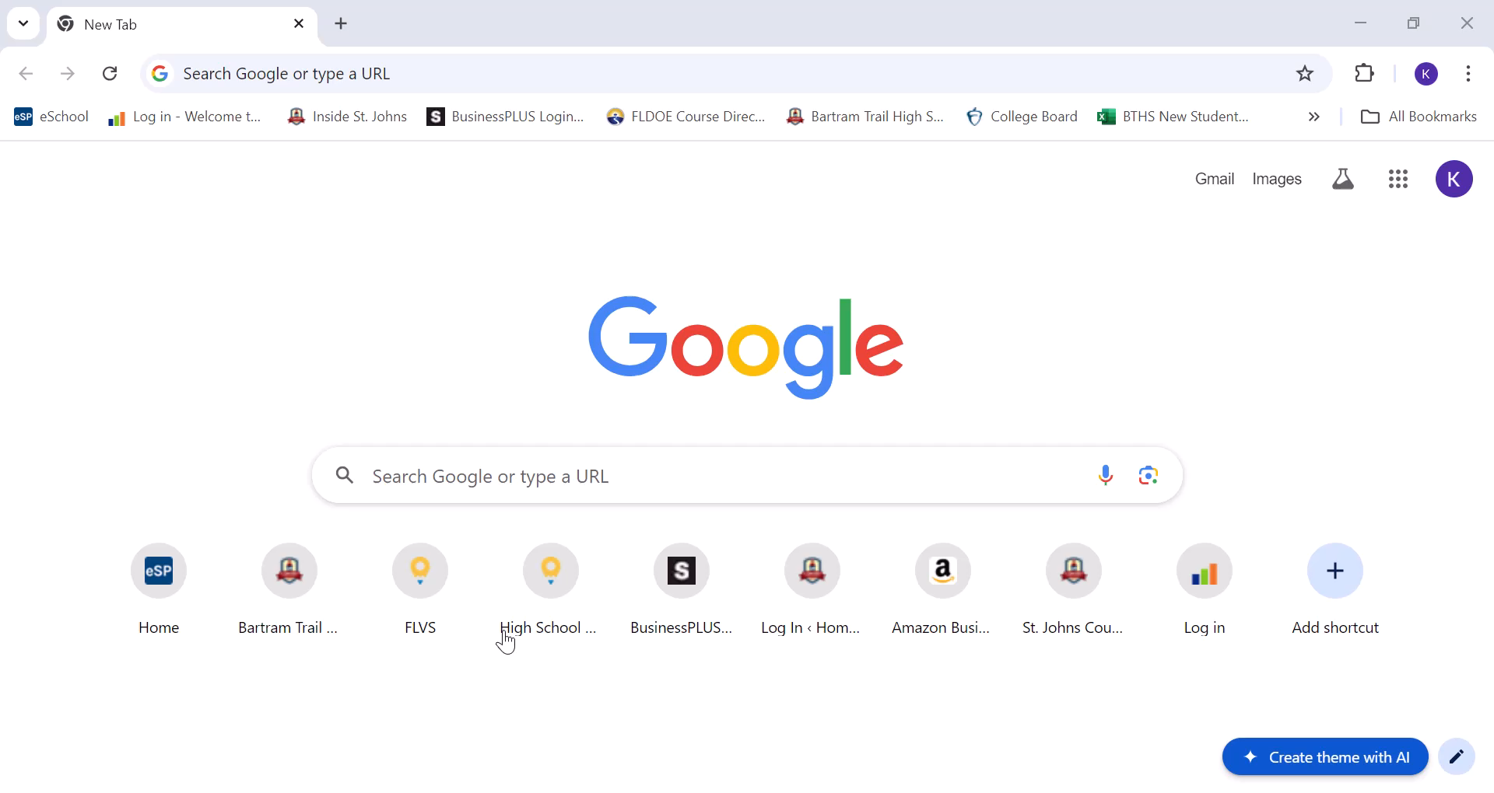
Scholarships on the BTHS Website
Go to the School Counseling Webpage
Scholarship Information
Scholarships by Monthly Deadlines
Scholarships – Information & Tips
Scholarships offered from specific schools
Scholarship Websites & Search Engines
District Scholarship Page

Slide 9
Other places Seniors can search for Scholarships:
Student’s Employers
Parent’s Employers
Church and Civic Organizations
Unions
Corporations
National, State, and Local Organizations
Special Interest Groups

Slide 10
Bartram Trail PTO
&
Athletic Boosters Club
For the last several years the BTHS PTO and the BTHS Athletic Boosters Club have offered scholarships solely to Bartram Trail Seniors!
This information is usually on the April Scholarship page.
There are other scholarships that are only for St. Johns County Students. Keep an eye out for those!

Slide 11
Reminder!
Seniors should be checking the monthly scholarship pages on the BTHS School Counseling Website frequently.

Slide 12
Hobbies and Interests can help pay for college!
Students may not think their hobbies and interests could help pay for college… but they should!
There are THOUSANDS of scholarships for things other than academics and athletics.

Slide 13
There are college scholarships out there for everyone!
Left-handed students
Zombie Apocalypse Scholarship
Make Me Laugh Scholarship
High school students who donate blood
Reading
Surfing
Gaming
Animal Lovers
Book worms
Music/Theatre/Dance
Religious Scholarships
Cancer Survivors
First in Family
Disability
Green
Vocational
Google
Search
AND SO MUCH MORE!

Slide 14

Please be aware of scams!
Never pay for scholarships or searches
Scholarships are gifts, they never have to be repaid!
DO NOT give your bank account, credit card, or social security information!

Slide 15

Florida
Bright Futures

Slide 16


Bright Futures and the Florida Lottery
The Florida Bright Futures Scholarship Program
establishes lottery-funded scholarships
to reward Florida high school graduates
for high academic achievement.

Slide 17
Bright Futures Student Handbook
Become more knowledgeable about Bright Futures by READING the Bright Futures Student Handbook.
www.floridastudentfinancialaid.org

Slide 18
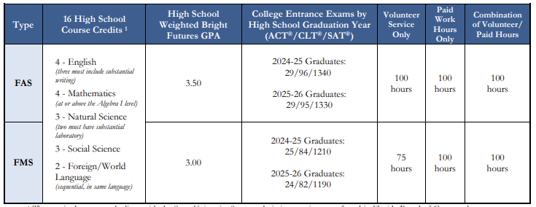
Florida Academic Scholar (FAS) and
Florida Medallion Scholar (FMS)
Gold Seal Vocational Scholar (GVS) can only be used to fund: an Applied Technology Diploma, Technical Degree Ed Program (Associate in Applied Science or Associate in Science), or a Career Education Certificate Program.

Slide 19
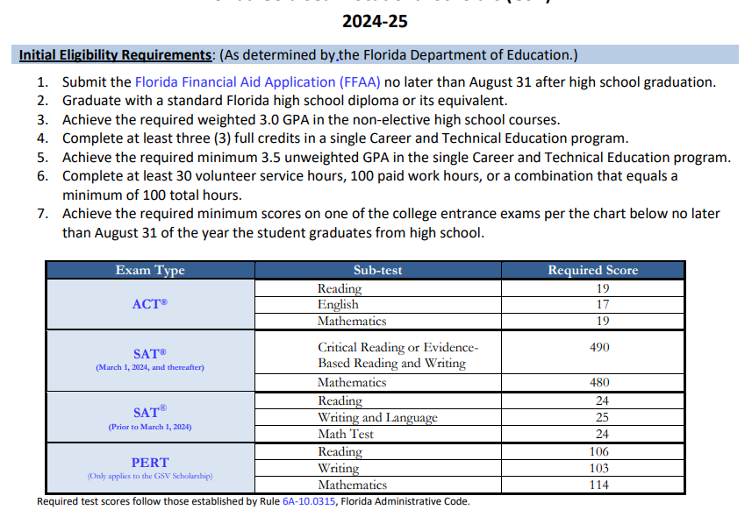
Florida Gold Seal Vocational Scholars (GSV)

Slide 20
Notes about
Florida Bright Futures
Bright Futures GPA is NOT the same as your cumulative weighted or unweighted GPA.
Bright Futures bases your GPA on 16 academic credits
  4 English, 4 Math, 3 Sciences, 3 Social Studies, and 2 Foreign Languages
Bright Futures weighs honors, AP, and dual enrollment classes equally with 0.5 per credit earned – NOT 1.0 weight for AP or DE.
Bright Futures will also accept two additional academic electives toward the GPA calculation if it benefits the student.

Slide 21
Notes about
Florida Bright Futures
You are permitted to use qualifying scores through August 31, 2025 for ACT, SAT or CLT to qualify for the Bright Futures test criteria if you did not qualify prior to graduation.
You must APPLY for the scholarship by submitting the Florida Financial Aid Application during senior year.
  The application opens each year on October 1.
Bright Futures Scholarships will renew automatically each year if the student maintains the required college GPA and credit hours.

Slide 22
Notes about
Florida Bright Futures
Bright Futures receives student transcript information (courses, grades, and community service/work hours) twice a year when the district uploads transcripts.
  end of 1st semester and end of 2nd semester/end of school year
Bright Futures receives ACT, SAT and CLT test scores ONLY when student reports scores to Florida state colleges and universities. Bright Futures will superscore the score reports sent to Florida state colleges and universities.
Bright Futures GPA CANNOT be viewed in HAC.
Juniors and Seniors will receive their Bright Future reports from their school counselor

Slide 23
Community service & work hours
Not needed for graduation
Needed for Bright Futures
The goal should be to complete 100 hours of community service/work hours by the end of 11th grade
Students may combine community service and work hours, but the hours must equal 100
How to find community service opportunities -
  https://www-bths.stjohns.k12.fl.us/guidance/community-service-hours/
REMINDER - Make sure the organization is a not for profit by searching by the name here
  https://search.sunbiz.org/Inquiry/CorporationSearch/ByName
Remember to keep a copy of verification letters for your records

Slide 24
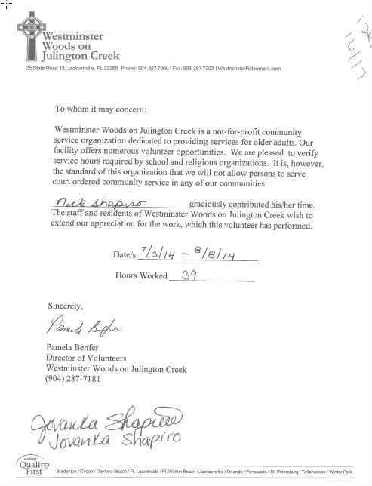
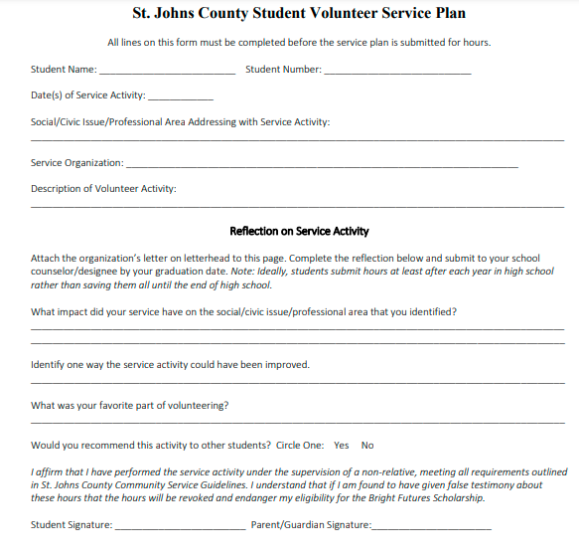
Submitting Community Service/Work Hours
SERVICE HOURS LETTER or Paystub
STUDENT VOLUNTEER SERVICE PLAN
Community Service verification letters or work paystubs can be turned into Ms. Richards in the school counseling area of the main building or emailed to Kathleen.Richards@stjohns.k12.fl.us

Slide 25
What should students do now to qualify for a Bright Futures Scholarship?
9TH GRADE
  Keep up with course work and establish a good high school GPA.
  Get involved in your school and community.
  Submit service/work hours to Ms. Richards in the Main School Counseling office or at Kathleen.Richards@stjohns.k12.fl.us

Slide 26
What should students do now to qualify for a Bright Futures Scholarship?
10TH GRADE
  Keep up with course work and maintain a good GPA.
  Seek out community service opportunities.
  Submit service/work hours to Ms. Richards in the Main School Counseling office or at Kathleen.Richards@stjohns.k12.fl.us
  Begin researching colleges.
  Begin planning for next year’s courses with college and Bright Futures in mind.

Slide 27
What should students do now to qualify for a Bright Futures Scholarship?
11TH GRADE
  Keep up with course work and maintain a good GPA.
  Check service/work hours in HAC. You should have at least 100 hours by now.
  Submit service/work hours to Ms. Richards in the Main Guidance office or at Kathleen.Richards@stjohns.k12.fl.us
  Schedule meetings with college representatives and ask questions about financial aid and Bright Futures.
  Begin planning for next year’s courses with college and Bright Futures in mind.
  Take SAT, ACT, CLT and send scores to a Florida school.

Slide 28
What should students do now to qualify for a Bright Futures Scholarship?
12TH GRADE
  Review your Bright Futures Report.
  See your school counselor if there are any errors on your transcript.
  Take note of what is “Missing” to qualify for each award.
  Take steps to improve your Bright Futures GPA if it is borderline.
  Submit any remaining service/work hours by winter break.
  Take or re-take SAT, ACT or CLT and report your scores to a Florida school.

Slide 29
What should students do now to qualify for a Bright Futures Scholarship?
12TH GRADE
  APPLY!
  APPLY NOW!
  DO NOT WAIT TO APPLY!
  Students do not have to be eligible for Bright Futures to apply. You can apply now and become eligible by graduation.
  You will NOT be eligible if you do not APPLY!

Slide 30
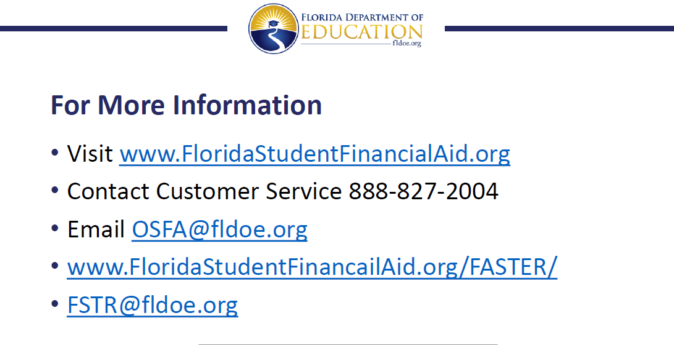
Florida Bright Futures

Slide 31
Counselors will be providing Financial Aid Workshops for Seniors during the month of October through English classes.
Remember!
Those students without an English class at BTHS will have an opportunity to sign up for a separate workshop.

Slide 32

Thank You!
☺

