Slide 1
BTHS Cheerleading 2017-2018

Slide 2
Team Make-up
Varsity: 16-24 girls
16 (Medium) with 4 alternates
20 (Large) with 4 alternates
Tumbling Requirements: TT BHS, Standing Tuck, Running Tuck
JV: 16-20 girls
Small JV 16 with 4 alternates
** Just because you were on a team the previous season doesn’t not guarantee you a spot the next year.

Slide 3
CODE OF ETHICS
A cheerleader is a representative of Bartram Trail High School whose purpose is to promote and uphold school spirit, as well as to represent BTHS to the highest degree possible in performance, in competition, and in daily life. A cheerleader’s behavior should exemplify good moral character, trustworthiness, friendliness, and leadership. She should be a positive role model for other students, and she should exhibit responsibility, dependability, and integrity for herself and others.

Slide 4
Key Points from the Constitution
Commitment is Vital!
Be there and be
on time.
Summer Practices, Camps, and Choreography
*Conditioning with Coach Aston (Varsity and JV) Thursday @ BT 8AM-10AM.
*Team Practice with Jessica Moltisanti at Zone
Varsity and JV- Wednesday 3:30-5:30
**UCA Camp–Varsity June 27-29(UCA Masters Camp-Invitation Only@ UCF)
July 22-25 (University of Central Florida) More information to come.
*Stunt/Skill Camp – TBD (at Zone in JULY…REQUIRED!)
*Each cheerleader should condition and practice chants on her own ALL SUMMER!
Regular Season Practices are Mandatory
Junior Varsity- Monday 4:30-6:30 and Wednesday 4:30-6:30 @ Zone; Tuesday 4-5:30 @ BTHS
Varsity- Monday 8:00-9:00 AM; Tuesday 4:30-6:30, Wednesday 3:30-4:30 and Thursday 4:30-6:30 @ Zone
*This starts in August.
We will make every effort to establish a practice time and stick to it; however, if the gym must be used for an athletic contest, our day or location may change.
NEW: Tardiness or unexcused absences from practices will result in demerits.
For each absence, you will be required to fill out an Absentee Form beforehand or if you are sick afterward with attached doctors note.
5 absences from practice will result in removal from routine. Excessive demerits could result in removal from the squad or in not being permitted to participate in a pep rally or game.

Slide 5
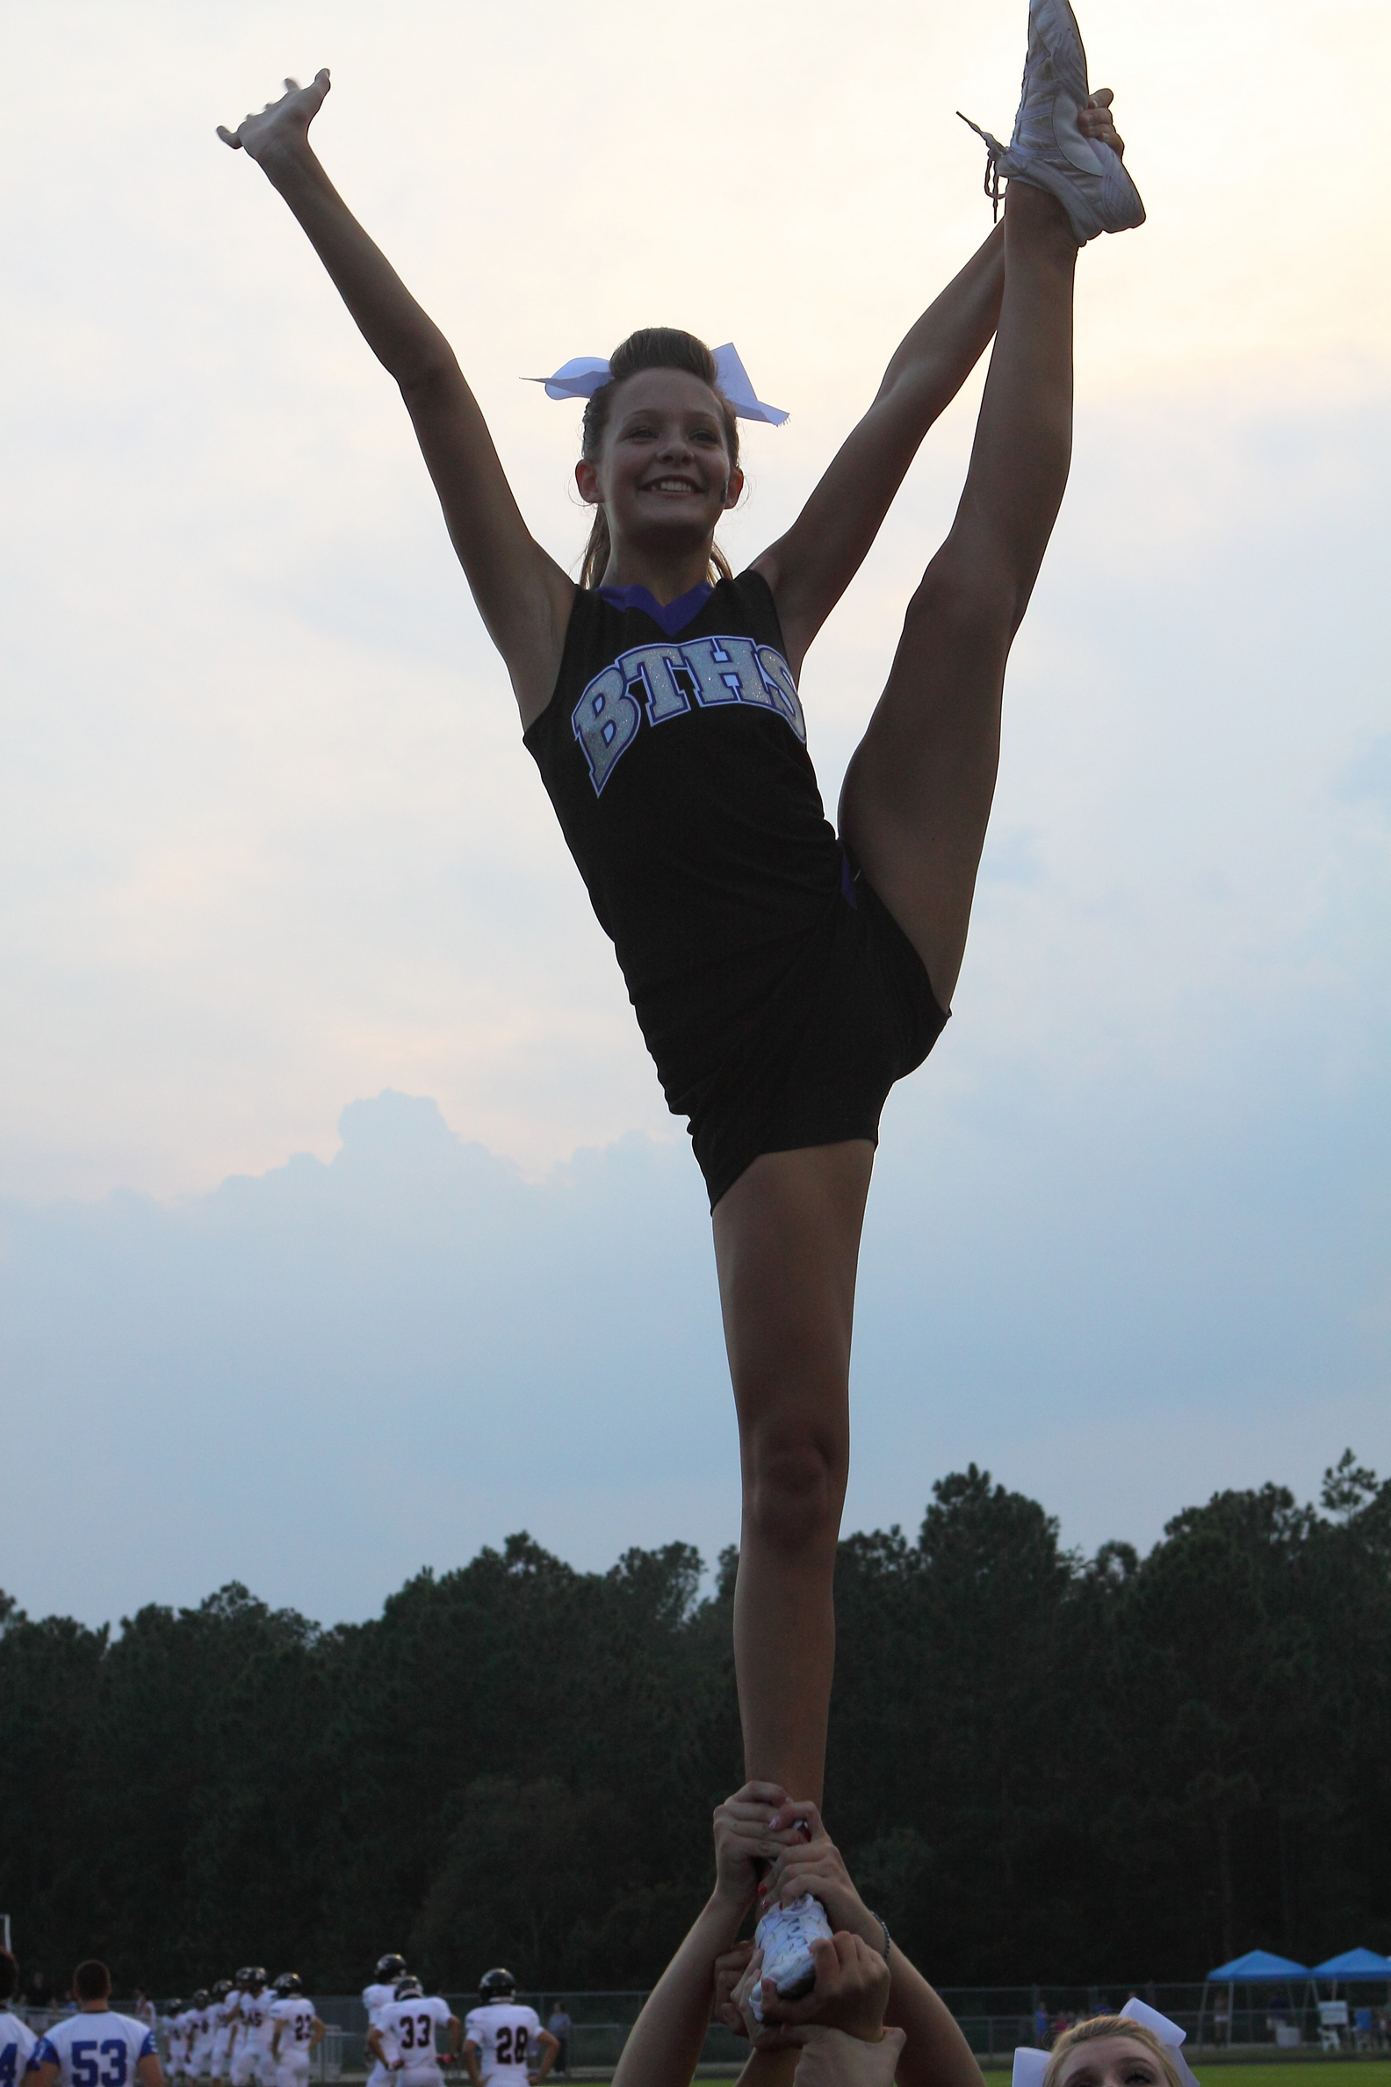
Money…That Touchy Subject
(This is only an estimate, as gym fees and competition costs have not been determined.)
Game/Stunt Camp appox. 375.00
(UCA Game Ready and Stunt Camp June 27-29 or July22-25, 2017)
Competition Choreography Camp (estimate only) 250.00
(Date to be determined by the availability of our choreographer)
Camp Wear/ Spirit Wear 150.00
(This includes four days of camp wear, most of which will also be worn as practice wear throughout the season.)
BTHS Game Ready Apparel 350.00
(This cost will vary depending upon what was purchased in previous years, but includes bloomers, cheer bag, warm-ups, body-liners, and cheer shoes.)
Uniform 275.00
(You will purchase one uniform. It will be worn at games and at competitions. If you purchased a uniform last year, you will not incur this cost.)
One time Gym Registration Fee (Due June) $30.00
Monthly Gym Fees (beginning in August) $65.00 V 55$ JV
Summer June-July (JV and Varsity) $30.00
(This does not include any optional private lessons your daughter may need in order to improve her tumbling.)
Competition Fees $TBD
(Costs will depend on entry fees as well as transportation and hotel expenses. After the squad is chosen, a parent meeting will be held to discuss competitions. In the past, these costs have been as low as $150.00 and as high as $800.00. It could be much less if we, as a squad, decide to limit the number of competitions we attend).
Plan on UCA Nationals $300-600 a girl (we will fundraise)
CHEERLEADING IS EXPENSIVE, BUT MEMORIES ARE PRICELESS!

Slide 6
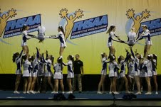
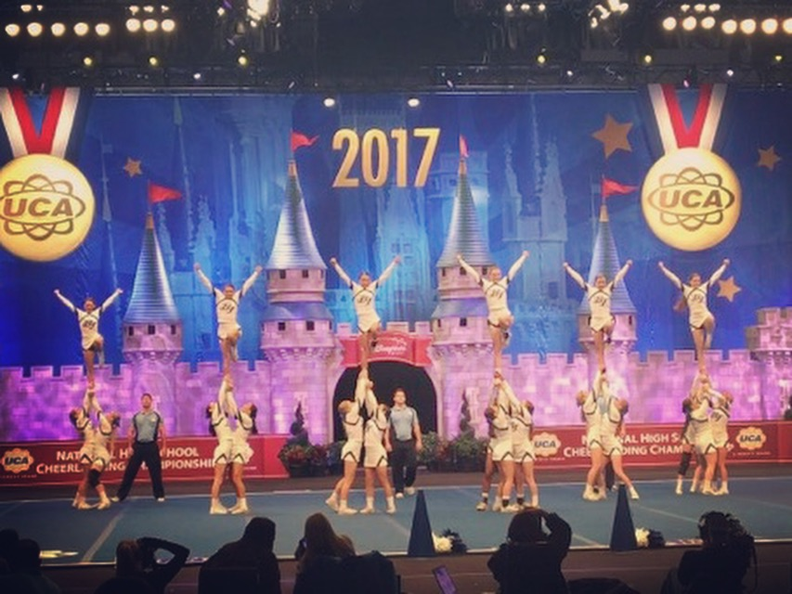
“Nothing is impossible; the word itself says, ‘I’m possible!’” ~Audrey Hepburn
Optional’ Workouts/Conditioning at Zone All-Stars Started March 22nd
Wednesdays 3:30-5:30
Contact ZONE for information.
Tryouts:
Monday, May 8th – Tryout Cheer and Dance Video Available
Friday, May 12th– Tryout Clinic 4-6PM @ BTHS
Monday, May 15th– Tryout @ BTHS 4 PM -whenever we are done.
‘

Slide 7
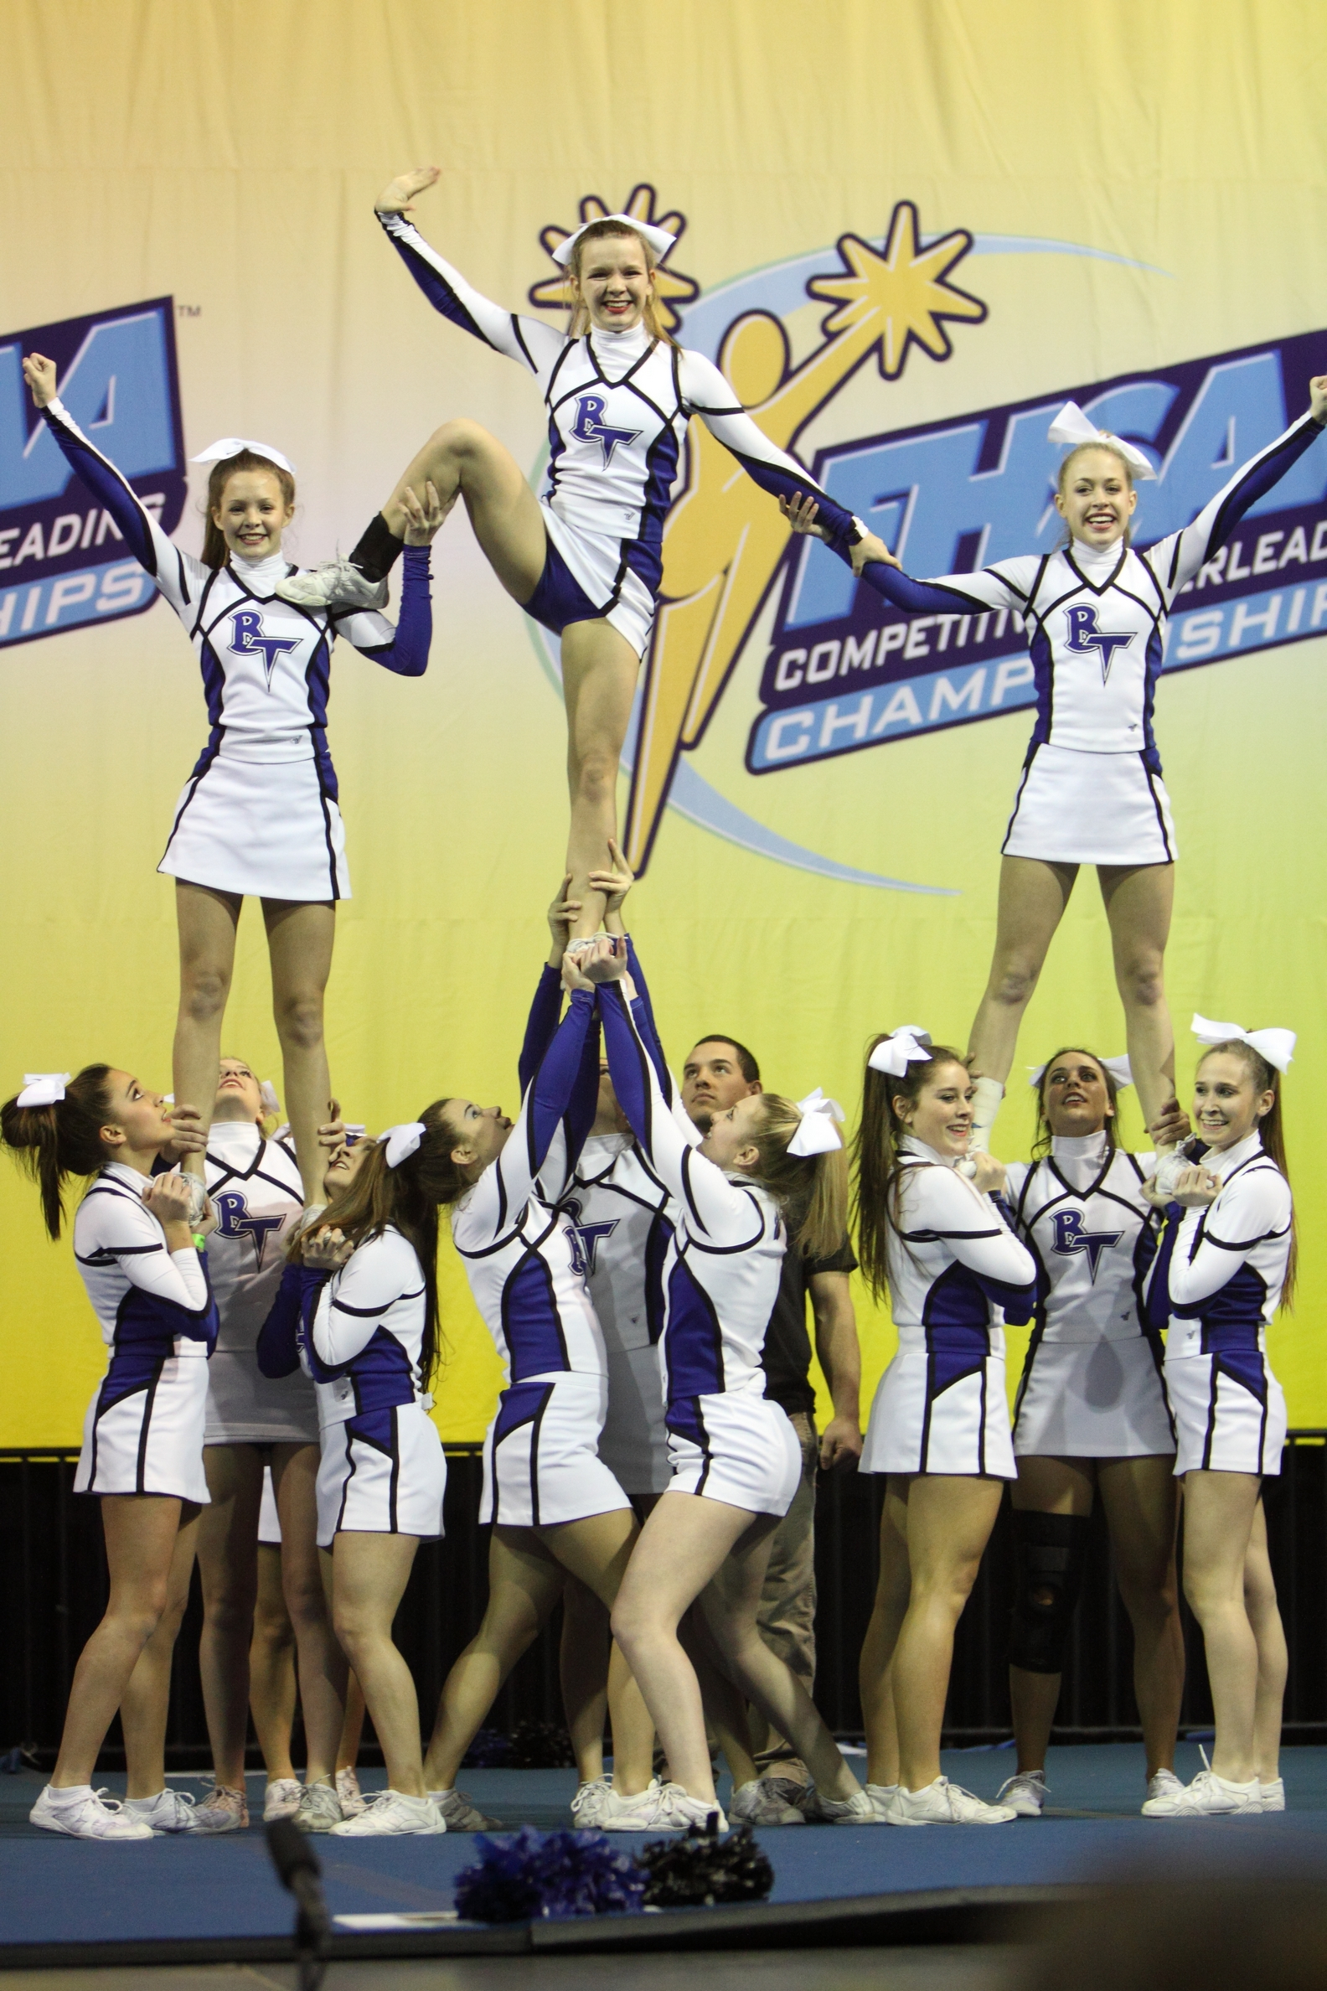
HOW WILL I BE JUDGED AT TRYOUTS?
*****Note: Like a football coach who only needs a certain number of quarterbacks, a cheerleading coach only needs a certain number of flyers, bases, and back spots. Besides skill, squad placement will be dependent upon what position you are capable of filling on the squad and squad need.
TEACHER RECOMMENDATIONS
GPA (WEIGHTED)
JUMPS (TOE TOUCH, PIKE, AND HURDLER)
MOTION TECHNIQUE
SPIRIT
DANCE RHYTHM
TIMING WITH YOUR GROUP (Dance ONLY)
INDIVIDUAL CHEER
CHANT (learned just prior to tryouts- ability to learn quickly is being judged here)
STANDING TUMBLING (HARD MAT)
RUNNING TUMBLING PASS (HARD MAT)
GENERAL CHEER PRESENCE…(SMILE, NATURAL ABILITY TO LEAD THE CROWD, VOICE)
REMEMBER…WHAT YOU THROW AT TRYOUTS, YOU MUST CONSISTENTLY THROW DURING THE SEASON OR YOU MAY NOT COMPETE!

Slide 8
You Will Need the Following...
Prior to Tryouts
During the Week of Tryouts
Pre-participation Athletic Health Physical (Download this form from the BTHS website.)
Parental Consent Form (downloadable from the Web)
A copy of your most recent report card.
Teacher Recommendations on File
Your Signed Cheerleading Constitution
Proof of Residency (If you do not currently attend BTHS or one of its feeder schools.)
Reliable transportation to and from BTHS for the clinics and tryout
Clinic Apparel
Sneakers or cheer shoes
Cheer shorts and a T-shirt
Hair pulled back in a tight, high ponytail.
Tryout Apparel
Sneakers or cheer shoes
Hair in a tight, high ponytail with a plain blue, black, or white ribbon
blue or black cheer shorts
a plain white T-shirt

